Slide 1




PHP Basic Syntax
Conditionals, Loops, Strings, Arrays
Basic Syntax
SoftUni Team
Technical Trainers
Software University
http://softuni.bg

Slide 2

Table of Contents
Conditional Statements
if and if else
switch case
Loops
while, do while
for, foreach
Strings
Arrays

Slide 3


What is PHP?

Slide 4

What is PHP?
PHP (PHP Hypertext Preprocessor)
Server-side scripting language for building dynamic Web sites
PHP code is embedded in HTML pages
Rendered to HTML at the Web server
This is HTML code
<ul>
<?php for($i = 1; $i <= 20; $i++) { ?>
<li><?= $i ?></li>
<?php } ?>
</ul>
This is PHP code

Slide 5
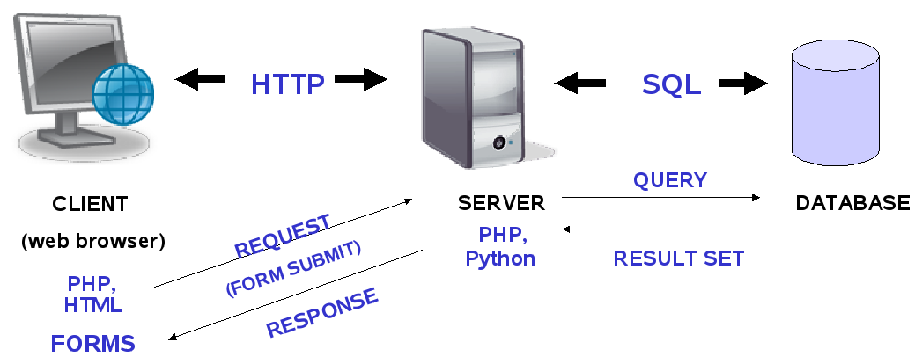
Web Server
The client only sees the result of the server's work, not the actual instructions.

Slide 6
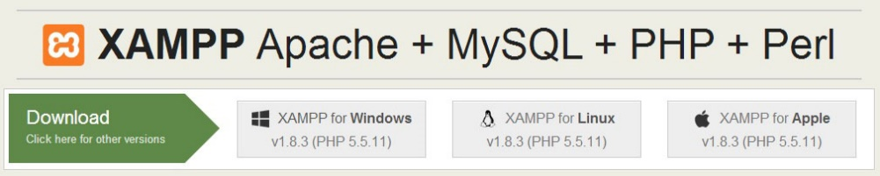
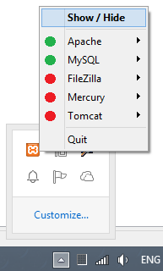
XAMPP
Downloading XAMPP:
https://www.apachefriends.org/download.html
Installing XAMPP for Windows:
Download the installer (run it as administrator)
Usual Windows installation: Next -> Next -> Finish
Running XAMPP
XAMPP start as a tray icon

Slide 7
Variables in PHP
Variables in PHP are prefixed by $, e.g. $count
Not declared, created at first assignment
Variables have a type, but it is not explicitly specified
echo $count; // Notice: Undefined variable: count
$count = 20; // variable $count, value 20 (integer)
echo $count . ' <br>'; // 20 <br>
echo gettype($count); // integer
var_dump($count); // int 20

Slide 8
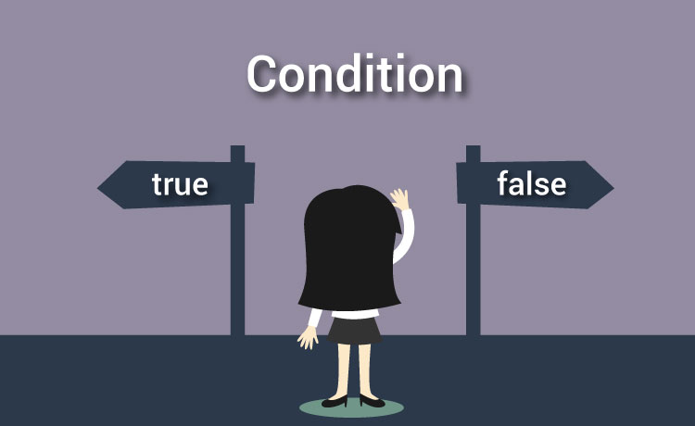
Conditional Statements
if, if-else, switch-case

Slide 9

If and If-else
PHP implements the classic if / if-else statements
$number = 5;
if ($number % 2 == 0) {
echo "This number is even.";
} else {
echo "This number is odd.";
}

Slide 10

If and If-else (2)
PHP offers an alternative syntax for the if-statement:
$a = 5;
if ($a == 5):
echo "a equals 5";
echo "...";
elseif ($a == 6):
echo "a equals 6";
echo "!!!";
else:
echo "a is neither 5 nor 6";
endif;

Slide 11
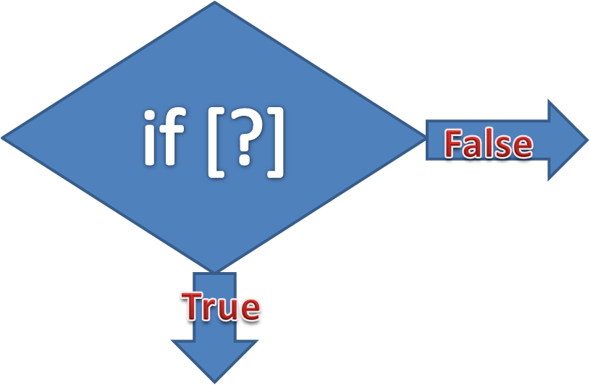
Practice: if and if-else
Live Exercises in Class (Lab)

Slide 12
Switch Case
Selects the case which matches the value of the switch expression and executes it
switch ($day) {
case 1: echo('Monday'); break;
case 2: echo('Tuesday'); break;
case 3: echo('Wednesday'); break;
case 4: echo('Thursday'); break;
case 5: echo('Friday'); break;
case 6: echo('Saturday'); break;
case 7: echo('Sunday'); break;
default: echo('Error!'); break;
}

Slide 13
Switch Case (2)
PHP offers an alternative syntax for the switch constructs:
$variable = 2;
switch ($variable):
case 1:
echo "<div>News</div>";
break;
case 2:
echo "<div>Forum</div>";
break;
endswitch;

Slide 14

Practice: Switch Case
Live Exercises in Class (Lab)

Slide 15

Loops
while, do-while, for, foreach

Slide 16

While Loop
While loops repeat a block of code if and as long as a certain condition is true:
$i = 0;
$num = 50;
while ($i < 10){
$num--;
$i++;
}
echo "Loop stopped at i= $i and num = $num";

Slide 17
Do-while Loop
Do-while loop executes a block of code at least once
It then continues to loop through the code as long as a certain condition is true
$i = 10;
do {
echo $i . " ";
$i--;
} while ($i > 0);
$i = -6;
do {
echo $i . " ";
$i--;
} while ($i > 0);
10 9 8 7 6 5 4 3 2 1
-6

Slide 18
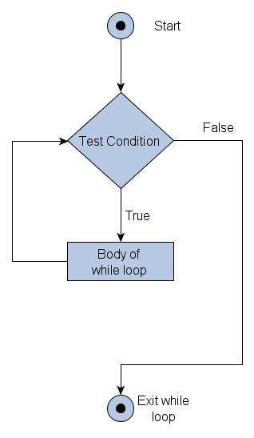
Practice: While Loops
Live Exercises in Class (Lab)

Slide 19
For Loop
For loop executes a block of code a specified number of times
for($i=0; $i<=10; $i++){
echo $i . " ";
}
for($i=10; $i<=0; $i--){
echo $i . " ";
}
0 1 2 3 4 5 6 7 8 9 10
10 9 8 7 6 5 4 3 2 1 0

Slide 20
For-Loop – Alternative Syntax
Printing blocks of different colors:
<?php
for ($r=0, $g=0, $b=0; $r < 256; $r+=16, $g+=8, $b+=4) :
$color = "#" .
str_pad(dechex($r), 2, '0') .
str_pad(dechex($g), 2, '0') .
str_pad(dechex($b), 2, '0');
?>
<div style="width:400px;
background-color:<?= $color ?>"> <?= $color ?>
</div>
<?php endfor; ?>
converts decimal to hexadecimal

Slide 21
Foreach Loop
The foreach loop iterates over arrays and objects
It also iterates over key-value pairs of associative arrays
$colors = ["one" => "red", "two" => "green"];
foreach ($colors as $key => $value) {
echo "k-> $key v-> $value <br>";
}
$colors = ["one" => "red", "two" => "green"];
foreach ($colors as $key => $value) {
echo "k-> $key v-> $value <br>";
}

Slide 22
Foreach – Alternative Syntax
Iterating over object properties:
<?php
$colors = (object)[];
$colors->red = "#F00";
$colors->slateblue = "#6A5ACD";
$colors->orange = "#FFA500";
foreach ($colors as $key => $value) : ?>
<p style="background-color:<?= $value ?>">
<?= $key ?> -> <?= $value ?>
</p>
<?php endforeach; ?>

Slide 23
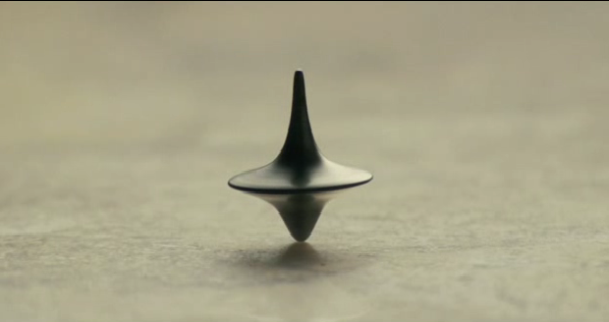
Practice: For Loops
Live Exercises in Class (Lab)

Slide 24

Strings
What is String?

Slide 25
Strings
Strings hold a sequence of non-Unicode characters
Single quoted string
$lang = 'PHP';
echo 'I love $lang\n';
// I love $lang\n
$str = 'I\'m a student at "Software University"';
echo $str;
// I'm a student at "Software University"

Slide 26
Strings (2)
Double quoted string
$lang = 'PHP';
echo "I love $lang\n";
// I love PHP
$str = "I'm a student at \"Software University\"";
echo $str;
// I'm a student at "Software University"

Slide 27
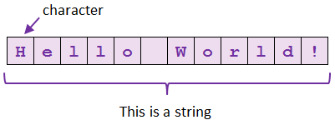
String Manipulation
Comparing, Concatenating, Searching, Extracting Substrings, Splitting

Slide 28
String Concatenation
In PHP there are two operators for combining strings:
Concatenation Operator
Concatenating Assignment Operator
$str = "I live in ";
$str .= "Sofia";
echo $str; // I live in Sofia
$str = "My hometown is ";
$town = "Varna"
echo $str . $town; //My hometown is Varna

Slide 29
Accessing Characters and Substrings
strpos($input, $find)
returns the index of the first occurrence of string in another string
strstr($input, $find, [boolean])
finds the first occurrence of a string and returns everything before or after
$str = "To be or not be that is the question.";
echo strpos($str, "that"); // 16
echo strstr("This is madness!\n", "is ") ; // is madness!
echo strstr("This is madness!", " is", true); // This

Slide 30
Accessing Characters and Substrings (2)
substr($str, $position, $count)
extracts $count characters from the start or end of a string
$str[$i]
$str = "abcdef";
echo substr($str, 1) ."\n"; // bcdef
echo substr($str, -2) ."\n"; // ef
echo substr($str, 0, 3) ."\n"; // abc
php $str = "Apples";
echo $str[2]; // p

Slide 31
Counting Strings
strlen($str)
returns the length of the string
str_word_count($str)
returns the number of words in a text
echo strlen("Software University"); // 19
$countries = "Bulgaria, Brazil, Italy, USA, Germany";
echo str_word_count($countries); // 5

Slide 32
Accessing Character ASCII Values
ord($str[$i])
returns the ASCII value of the character
chr($value)
returns the character by ASCII value
$text = "Call me Banana-man!";
echo ord($text[8]); // 66
$letter = chr(109);
echo "ASCII number 109 is equivalent to $letter\n"
// ASCII number 109 is equivalent to m

Slide 33
String Replacing
str_replace($target, $replace, $str)
replaces all occurrences of the target with the replacement string
str_ireplace($target, $replace, $str)
case insensitive replacing
$email = "user@mail.com";
$newEmail = str_replace("user", "pesho", $email);
echo $newEmail; // pesho@mail.com
$text = "HaHAhaHAHhaha";
$iReplace = str_ireplace("A", "o", $text);
echo $iReplace; // HoHohoHoHhoho

Slide 34
Splitting Strings
str_split($str, $length)
splits each character into a string with a specified length and returns an array
explode($delimiter, $string)
$text = "Hello how are you?";
$arrSplit = str_split($text, 5);
var_export($arrSplit);
// array ( 0 => 'Hello', 1 => ' how ', 2 => 'are y', 3 => 'ou?', )
echo var_export(explode(" ", "Hello how are you?"));
// array ( 0 => 'Hello', 1 => 'how', 2 => 'are', 3 => 'you?', )

Slide 35
Case Changing
strtolower()
strtoupper()
$str[$i]
php $lang = "JavaScript";
echo strtolower($lang); // javascript
php $lang = “php";
echo strtoupper($lang); // PHP
$str = "Hello";
$str[1] = 'a';
echo $str; // Hallo

Slide 36
Other String Functions
strcmp($string1, $string2)
performs a case-sensitive comparison
trim($text)
Both strings are equal
echo strcmp("Hello, world!", "Hello, world!") // 0
echo strcmp("Hello, world!", "Hello") // 7
echo strcmp("Hello", "Hello, world!") // -7
String1 is longer than string2
String1 is shorter than string2
$boo = " \"it's wide in here\" ";
echo trim($boo); // "it's wide in here"

Slide 37



Practice: String Manipulation
Live Exercises in Class (Lab)

Slide 38
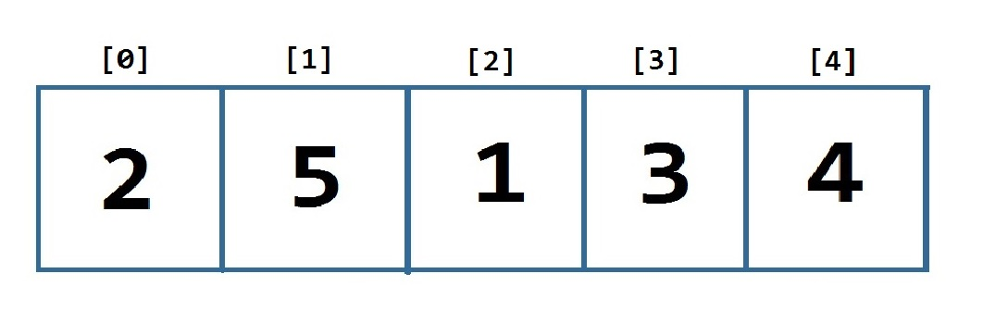
Arrays
Working with Array of Elements

Slide 39
Initializing Arrays
There are several ways to initialize an array in PHP:
Using the array() language construct:
Using the array literal []:
Using array_fill($startIndex, $count, $value):
$newArray = array(1, 2, 3); // [1, 2, 3]
$newArray = [7, 1, 5, 8]; // [7, 1, 5, 8]
$newArray = array_fill(0, 3, "Hi"); // ["Hi", "Hi", "Hi"]

Slide 40
Array Manipulation
Accessing / Changing element values
Iterating through an array
$cars = ['BMW', 'Audi', 'Mercedes', 'Ferrari'];
echo $cars[0]; // BMW
$cars[0] = 'Opel';
print_r($cars); // Opel, Audi, Mercedes, Ferrari
$teams = ['FC Barcelona', 'Milan', 'Manchester United', 'Real Madrid', 'Loko Plovdiv'];
for ($i = 0; $i < count($teams); $i++) {
echo $teams[$i];
}

Slide 41
Array Manipulation (2)
array_push($array, $element1, $element2, …)
unset($array[$index])
$months = array();
array_push($months, 'January', 'February', 'March');
$months[] = 'April'; // ['January', 'February', 'March', 'April']
Alternative syntax
Indices remain unchanged
$array = array(0, 1, 2, 3);
unset($array[2]);
print_r($array); // Array ([0] => 0 [1] => 1 [3] => 3)

Slide 42
Array Manipulation (3)
array_splice($array, $startIndex, $length,[$element])
array_pop($array)
$names = array('Joe', 'Peter', 'Richard', 'John');
array_splice($names, 1, 2); // ['Joe', 'John']
array_splice($names, 1, 0,'Jim'); // ['Joe','Jim','John']
$fruits = array('orange','banana','apple', 'kiwi');
echo array_pop($fruits); // 'kiwi'
print_r($fruits); // ['orange', 'banana', 'apple']

Slide 43
Array Manipulation (4)
array_shift($array)
array_unshift($array, $element1, $element2,…)
$fruits = array('orange','banana','apple', 'kiwi');
echo array_shift($fruits); // 'orange'
print_r($fruits); // ['banana', 'apple', 'kiwi']
$fruits = array('apple', 'kiwi');
array_unshift($fruits,'orange','banana');
print_r($fruits); // ['orange','banana','apple','kiwi']

Slide 44
Array Manipulation (5)
asort($array)
arsort($array)
$fruits = array('orange','banana','apple', 'kiwi');
asort($fruits);
print_r($fruits); // Array([2] => 'apple', [1]=>'banana', [3] =>'kiwi', [0] => 'orange')
$fruits = array('orange','banana', 'apple', 'kiwi');
arsort($fruits);
print_r($fruits); // Array([0] => 'orange', [3] =>'kiwi',
[1] =>'banana', [2] => 'apple')

Slide 45

Practice: Array Manipulation
Live Exercises in Class (Lab)

Slide 46

Summary
Conditional statements execute some code if the condition is true
if, if-else, switch-case
Loops execute a block of code a specified number
of times or as long as a specified condition is true
while, do-while, for, foreach
Strings are sequences of characters.
PHP provides many built-in functions for manipulating strings.
Arrays hold indexed sequence of values

Slide 47







PHP Basic Syntax
https://softuni.bg/courses/php-basics

Slide 48
License
This course (slides, examples, demos, videos, homework, etc.) is licensed under the "Creative Commons Attribution-NonCommercial-ShareAlike 4.0 International" license

Slide 49





Trainings @ Software University (SoftUni)
Software University – High-Quality Education, Profession and Job for Software Developers
softuni.bg
Software University Foundation
softuni.org
Software University @ Facebook
facebook.com/SoftwareUniversity
Software University Forums
forum.softuni.bg

